Slide 1
ANALYTICS 102
WEBINAR
Presented by:
Dominik Dietz

Slide 2
Rules
Everyone is placed on “mute” for webinar, but please type questions into the chat so these can be responded to at the end or as we go.
The end of the call will be a Q&A session. Please be respectful and I will do my best to answer questions in the order they come in.

Slide 3
Live Demo
Once you login to Google Analytics you will select your website from the list of profiles.
I am going to use the RevolutionParts Knowledge Base site for the purpose of this demonstration.

Slide 4
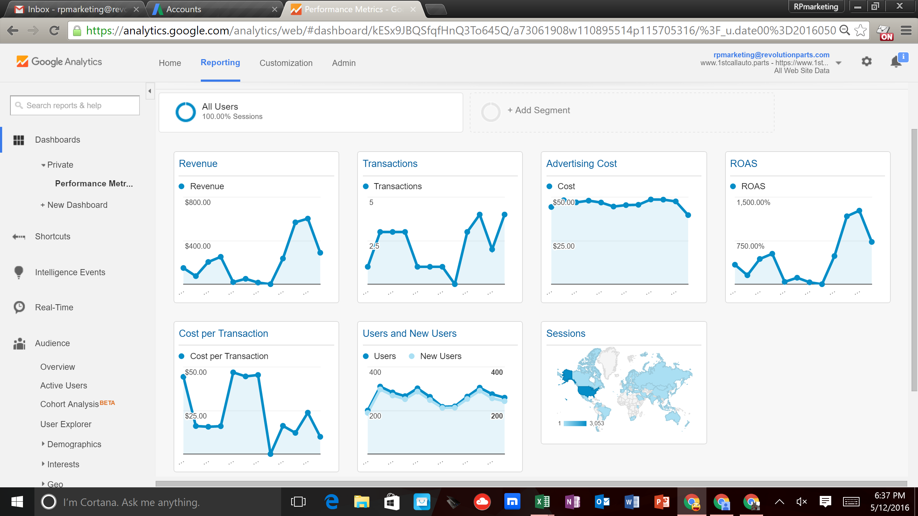
Creating Customized Dashboards
Step by step on how to set up a custom dashboard

Slide 5
AdWords Linking/Ecommerce Set-Up
How link AdWords to Google Analytics
Set up ecommerce tracking
Import goals (orders) into AdWords

Slide 6
Acquisition Tab
Where are my customers coming from?
How long are they staying on my site?
Are they buying?
Why are they not buying?

Slide 7
Behavior Tab
User Flow
Analyzing Exit Pages
Analyzing Landing Pages

Slide 8
Questions & Answers

